Slide 1
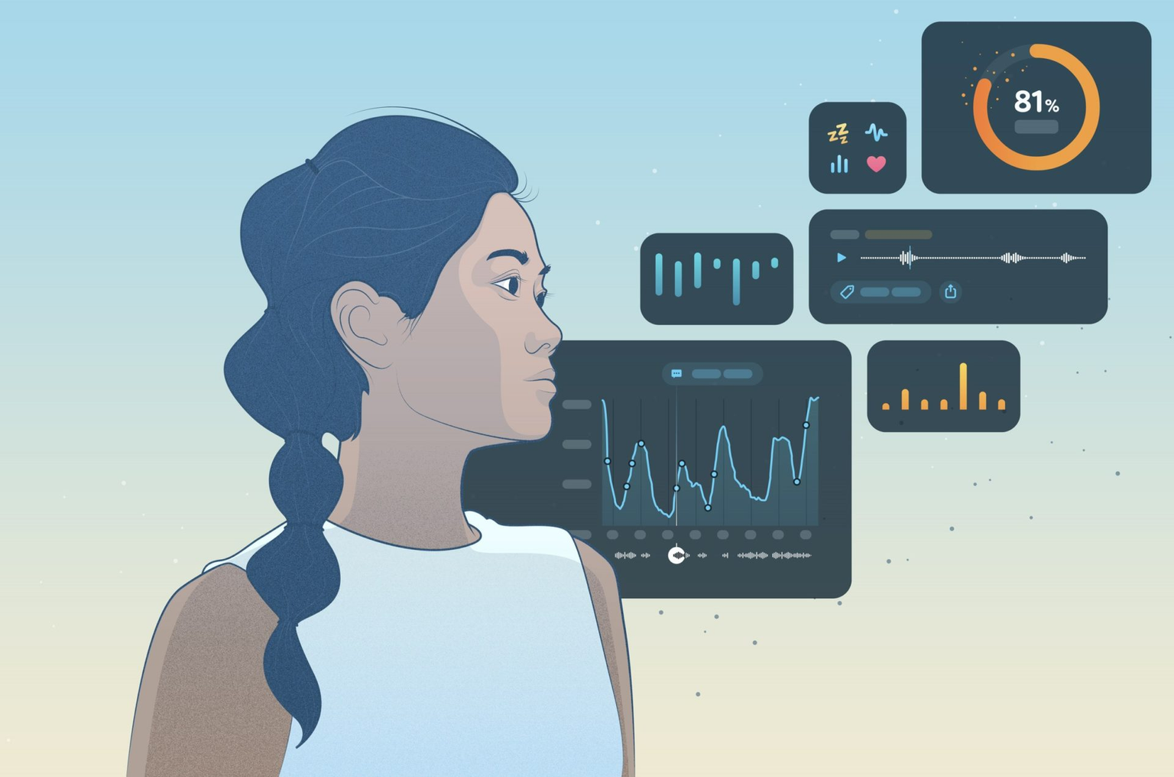

SMART PILLOW
GROUP 5

Slide 2
Acknowledgement
We would like to express our gratitude to Prof. Priyanka Bagade, TA Aditya Loth, TA Alok Kumar, TA Ravi Shankar Das, TA Rahul Kumar, TA Ayushi Mishra and TA Subhajyoti Saha for guiding and supporting us through out the Course and Project.

Slide 3
Group - 5
NAME
ROLL NO.
Yukkta Seelam
Ankur Kumar
Batta Soumith
Manas
Ajeet
201167
200140
200264
200554
22111005

Slide 4
Work Distribution
TEAM MEMBER
WORK IN PERCENTAGE
Yukkta
Ankur
Soumith
Manas
Ajeet
24 ML for Apnea
26.8 Backend
23 ML for Snore detection
26 Frontend
0.2 Report

Slide 5
Motivation
Sleep is a period of rest during which we relax our body and let our body regulate various bodily functions. Sleep is essential to us as it affects our mental and physical state and functioning. Sleep touches every aspect of the health of our body and is truly essential for our well-being. Sleep is vital for the proper development of their mind and body.
However, in today's chaotic world, it has become challenging to have a decent sleep schedule, and we have lately been neglecting our sleep hence, affecting our mental and physical well-being. Mental disorders like depression, stress, anxiety, etc., result from lack of proper sleep. People suffer from constant headaches and mental disorders, yet they refuse to change their sleep schedule. Recent studies show that a large proportion of adolescents lack proper sleep, and thus, we see them suffering from chronic mental disorders nowadays.

Slide 6





Final Model
Ecg and other data
Body Sensors
Pillow
Server
Display API
Writes raw reading from
the sensors so that the
pillow can access the data
If the data changes we send
it to the server
The data is stored, fed into
models and the result is shown

Slide 7
Sleep Apnea Detection
Data:
ECG data from 35 different people is used. Their respective ages, and sex is known too.
Feature Extraction:
Raw ECG data is not very useful as it is hard to understand the data. Therefore only the uselful features are extracted from it and saved as the input to the model.

Slide 8
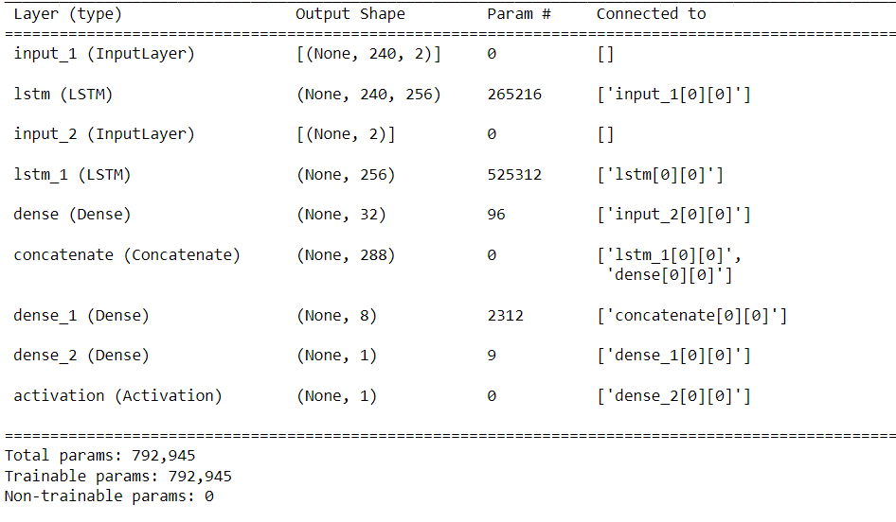
Model:
The model consists of 2 LSTM layers for the input, followed by a dense layer, concatenation of the LSTM and dense layers, again followed by 2 dense layers and finally the activation layer.

Slide 9
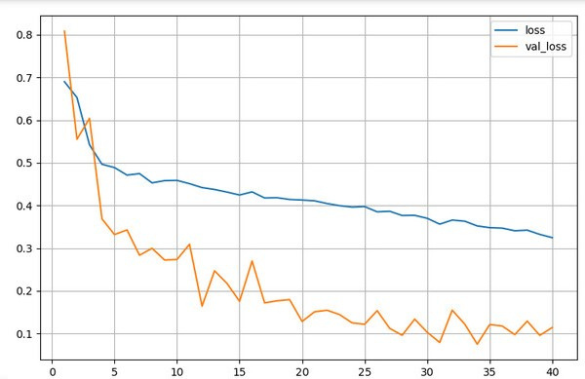
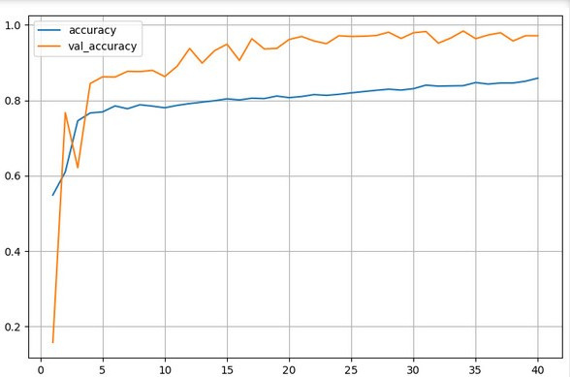
Loss Vs. Epochs:
Accuracy Vs. Epochs:

Slide 10
Snore Detection
Snoring, whilst potentially embarrassing for a snorer, can have greater health implications such that correct identification of its cause can save lives. For example, Obstructive Sleep Apnea (OSA), a disorder that results from blockage of upper airways during sleep, can provoke damaging short and long-term effects on a person's well-being and can even cause death.

Slide 11
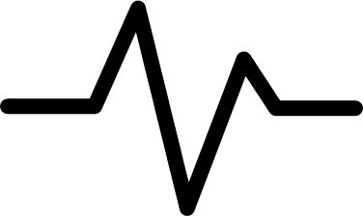
Model
Data
Munich-Passau Snore Sound Corpus
Spectrogram
CNN layer
Channel Slice
Output
Input Audio

Slide 12
Let us now look at
a demo on the working

Slide 13
Challeges
There is currently very little data available for sleep apnea prediction using ECG readings.
No prior experience working with ECG data therefore was challenging to understand and extract useful information from it.
Since not being well-versed in Machine Learning, took a lot of effort and time to build and run models.
Hard to obtain hardware therefore could not implement it.

Slide 14
Future Scope
Adding more secure protocols and authorization like JWT Tokens with HSA256 hashing.
Observe the temperature and humidity and connect the IoT board to the thermostat in the room to actuate and regulate the temperature of the room pertaining to which the user has the deepest sleep.
Add pillow shape transform depending upon the pressure value by the pressure sensor. More pressure on the pillow would signify a deeper and more relaxed sleep hence, we could actuate the pillow shape.
Determine the time periods when the user had the deepest sleep after playing the music and can continue to play or stop the music depending upon that.
Make a mobile friendly web-app with interactive graph and realtime updates.

Slide 15
References
https://ieeexplore.ieee.org/stamp/stamp.jsp?tp=&arnumber=894630&tag=1
https://dl.acm.org/doi/abs/10.1145/2461381.2461405
https://ijartet.com/1532/v3s19kingsinternat/conference
https://ieeexplore.ieee.org/abstract/document/8553521
https://github.com/JackAndCole/Sleep-apnea-detection-through-a-modified-LeNet-5-convolutional-neural-network
https://github.com/Bettycxh/Toward-Sleep-Apnea-Detection-with-Lightweight-Multi-scaled-Fusion-Network

